Slide 1

CASE STUDY 1
Swami Vivekananda Yoga Anusandhana Samsthana, Bengaluru
SVYASA Yoga University
Arogyadhama Presentation On
Cyclothymia
Section C-MAMATHA
Life Science
Presented By: Mridhul TP, Student – M.Sc. (Yoga) Therapy
Registration No. 40119159

Slide 2
1. Introduction to the Section:
1.1 Section Name: Section C-MAMATHA (Anxiety and Depression)
1.2 Doctor In-charge: Dr Kshama
1.3 Therapist: Mr Siddhanagaraj & Mr Deleep
1.4 Consultant: Dr. R. Nagaratna
2. Introduction to the Ailment:
2.1 Definition: Cyclothymia (sy-kloe-THIE-me-uh), also called cyclothymic disorder, is a persistent mild mood disorder. Cyclothymia causes emotional ups and downs, but they're not as extreme as those in bipolar I or II disorder, but often long lasting. A person with cyclothymia has both high and low mood, but never as severe as either mania or major depression.
According to the most recent Diagnostic and Statistical Manual of Mental Disorders (DSM-V), cyclothymia is distinguished from bipolar disorder because it lacks the full criteria of major depression, mania, or a mixed episode disorder. However, some people with cyclothymia will develop bipolar I or bipolar II disorder later in life.

Slide 3
2.2 Causes:
The causes of cyclothymia are not known, but there's probably a genetic link because cyclothymia, depression and bipolar disorder all tend to run in families. In some people, traumatic events or experiences may act as a trigger for the condition, such as severe illness or long periods of stress.
research shows that it may result from a combination of:
Heredity, as cyclothymia tends to run in families
Differences in the way the brain works, such as changes in the brain's neurobiology
Environment, such as traumatic experiences or prolonged periods of stress
2.3 Signs and Symptoms:
The highs of cyclothymia include symptoms of an elevated mood (hypomanic symptoms). The lows consist of mild or moderate depressive symptoms.
Periods of feeling low followed by periods of extreme happiness and excitement (called hypomania) when you do not need much sleep and feel that you have a lot

Slide 4
of energy. The periods of low mood do not last long enough and are not severe enough to be diagnosed as clinical Depression.
Might feel sluggish and lose interest in things during these periods, but this should not stop you going about your day-to-day life.
Mood swings will be fairly frequent – you will not go for longer than 2 months without experiencing low mood or an emotional high.
Symptoms of cyclothymia are not severe enough for to be diagnosed with bipolar disorder, and mood swings will be broken up by periods of normal mood.
2.4 General line of treatment
Treatment usually involves medicine and some kind of talking therapy and counseling
Medicine may be prescribed:
anti-anxiety medications such as benzodiazepine
anti-seizure medications
mood stabilizers
Antidepressants

Slide 5
Psychotherapy : such as cognitive behavioral therapy (CBT), can help with cyclothymia. CBT involves talking to a trained therapist to find ways to help you manage your symptoms by changing the way you think and behave.
3. CASE STUDY:
1.1 Biographic Data:
Name: Mr X
Address: Kerala
Age: 25
Sex: Male
Marital Status: Unmarried
Education Qualification: MBA
Occupation: Data Analyst
Date of Admission: 15-02-2021
Date of Discharge: Discharge (As on 02-march-2021)
3.2Chief Complaint:
Participant has anxiety since childhood.

Slide 6
Participant said that he is having periods of feeling low mood followed by periods of extreme happiness and excitement over 2 to 3 years or even before.
3.3 History of Present Illness:
Participant has no idea about when aforementioned symptoms actually started however he recollected that he has anxiety since childhood.
1 years back he noticed frequent swings between high and low mood. but, he was more likely fatigue or low energy , feelings of hopelessness, worthlessness, or guilt , inattentiveness, lack of concentration etc. by the time, He was told to perform exercises on regular basis and took Allopathic medication. He took this continuously over 3 to 4 month and get stable some time for a month. But again issue got popped up. Afterwards he has been taking it whenever he felt psychological ups and down..
Now a days, he has been experiencing the same emotional ups and down. Though, he thinks that he is more hyper active, argumentative and he got impulsive behavior, going for days with little or no sleep (without feeling tired), excessive talking or speaking very quickly. sometimes he talk so fast so that others have trouble to follow him.

Slide 7
3.4 Past History:
(1) Childhood disease: He has anxiety since childhood but not taking any medication.
(2) Allergies: “Nothing “ mentioned by participant
(3) Accidents and Injuries: No
(4) Hospitalization: No
(5) Medication: He took antidepressants along with mood stabilizers for mood swing.
3.5 Family History of Illness:
(1) Paternal: Father has Bipolar Disease.
(2) Maternal: Mother has Thyroid
(3) Sibling: Sister has Anxiety
3.6 Personal History:
(1) Addictions if any: Smoke Frequently
(2) Nutrition Pattern:
a. Vegetarian/Non-Vegetarian: Non - Vegetarian
b. Typical daily food intake: 2 to 3 times a day.

Slide 8
c. Typical daily fluid intake: nearly 1 litres.
d. Weight loss/gain ? Amount: No significant change in weight
e. Appetite: Normal
(3) Elimination Pattern:
a. Bowel: Once in a day
b. Bladder: 2-3 times / day
c. Sweat: Often
(4) Menstrual History: Not Applicable
(5) Activity-Exercise Pattern:
a. Duration/Type of exercise: Rarely do exercises.
b. Spare time activity: participant is little introvert and always keep low profile. Most of the time spent at office and his room ( Reading books and Browsing).
(6) Sleep Rest Pattern: 3 to 5 hours sleep these days (without feeling tired).
3.7 Stress History: participant said that he has occupational and some other unexplained stress.

Slide 9
3.8 Examination:
1. Vital Signs
a. Pulse: 81 beats/minute
b. Respirator Rate: 23 cycles/minute
c. Blood Pressure: 131/81 mmHg
2. Anthropometric Measurements
a. Height: 173 centimeters
b. Weight: 78 kg.
c. Body Mass Index (BMI) kg/m²: 26.06
3.9 Investigations and findings:
Through our analysis, we could understand that, His sister has anxiety , mother got thyroid issue, father has bipolar disorder and he is having occupational and other unexplained stress with emotional variation this indicate possibility of bipolar diseases.
Now, inappropriate usage of antidepressant and mood stabilizers, improper self care and life style are made his condition as worsen as emotional instability with hypomania.

Slide 10
even though participant has stress ,found variation in parameter and mood instability he is very successful in his career.
Moreover, all investigation and analysis shows that his symptoms are less sever than bipolar disorder I & II.
4. Final Diagnosis: Considering all the facts finally we reached at a conclusion, Participant has cyclothymia. (We assume, 1 year back participant was Diagnosed cyclothymia with intensified depressive symptom. Now, inappropriate and intermittent consumptions of antidepressant , poor self care and life style has left him cyclothymia with exaggerated hypomania)
5.Treatment/Management:
Yoga:
Annamaya Level / Physical : Special technique for anxiety ,mood swing.
Ahara : Satvik diet
Pranamaya Level /Breathing : Pranamaya and Breathing practices to improve
Self Control.
Manonmaya Level / Meditation : Om, cyclic Meditation, MSRT ,MEMT PET
Vijnanamaya Level / Counselling : Read and follow bhakti yoga ,karma yoga and jnana Yoga and rajayoga for life style modification.

Slide 11
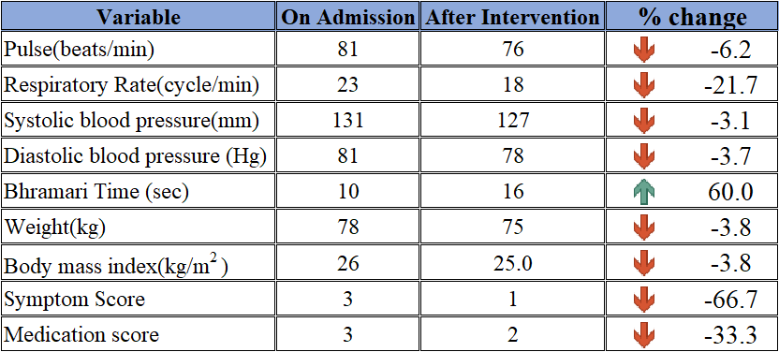
Anandamaya Level/ Self : Find enjoyment in all and to realize the happiness is within
Ayurvedic Treatment :
Panchakarma treatment advised to participant.
Ayurvedic Medication : Manasa Mitra Vadakam (2-0-2) AF
: Brahmi Gritham ( 1tsp -0- 1tsp) BF
6. Parameters
All the Details of variables are given below.
Note: Percentage change formula: ((AY-OA) / OA)*100

Slide 12
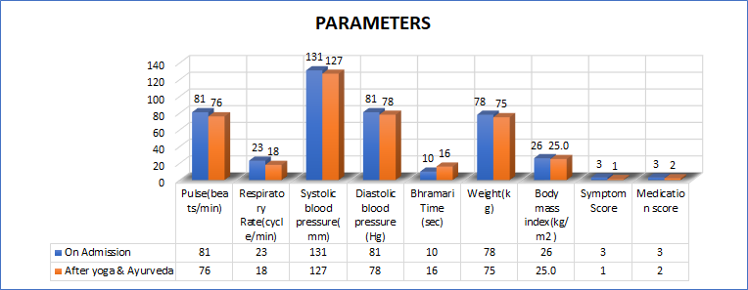
Graph of Parameters

Slide 13
Conclusion:
After intervention and analysis of all variable we found improvement in Participant as follows.
Stress has been Reduced.
Improved Anthropometric Measurements
Improvement in depression and maniac symptom (Found development in emotional instabilities)
cyclothymia is probably a long term disease. So it require prolonged self care and life style modifications. Hence, We advised him to take Panchakarma Treatment and ayurvedic medication until symptom get ease. also suggested with extended practice of yoga.
Advice : When you think that you are dull, fatigue, tired etc.. Try to engage in any activity (consciously) activate and energize whole body. When you get full of thought ,distraction, speed etc try to slow and calm down the mind through IAYT technique. whenever do something should be done consciously. Get awareness to all aspect of life and bring inner harmony this can improve your health.
7.1 Participant’s Feedback: The participant said that, nowadays he has self improvement. He really feel worth to be here in prashanthi kutiram.
7.2 Practices found beneficial by participant :The participant is completely satisfied with IAYT MODULE and ayurvedic treatment. however , he suggested that, including more lecture session would be great to get more knowledge of life science.

Slide 14
Thank You

